Slide 1


Measuring the User,
Not the Model
AIME-CON 2026 · PAPER SESSION
Critical AI Literacy and the Verification Frontier
Derek Briggs
University of Colorado Boulder
Wednesday, October 7, 2026 · Pittsburgh
Notes:
The title for the talk has two halves. "Measuring the user, not the model" is the argument. "The verification frontier" is a result from a simulation. The full argument and the derivations are in the proceedings paper. Today I'll move quickly through the argument and spend most of my time on the measurement model and the simulation.

Slide 2
The Jagged Frontier of LLMs
OPENING
MY PROMPT
LLMs can solve problems that would stump an expert, but they struggle to deliver a funny joke.
Write a super funny joke about pelicans.
CLAUDE (OPUS 4.6)
A pelican walks into a bar. The bartender says, “Why the big bill?”
The same system will, minutes later, debug code that implements a parameter estimation algorithm.
“Jagged technological frontier”: Dell’Acqua et al. (2023)
Notes:
Generative AI systems can solve problems that would stump an expert, and then stumble on something a person finds easy. As part of a blog post, channeling a great LLM tutorial by Andrej Karpathy, I asked Claude for a super funny joke about pelicans. Let's just say it's not super funny, even as a dad joke. Minutes later the same system will debug code for a parameter estimation algorithm. The key is in verification and the difference between RL and RLHF. Code has a check: it runs or it does not. A joke for a dinner party has no check until the party. Keep this distinction in mind.

Slide 3
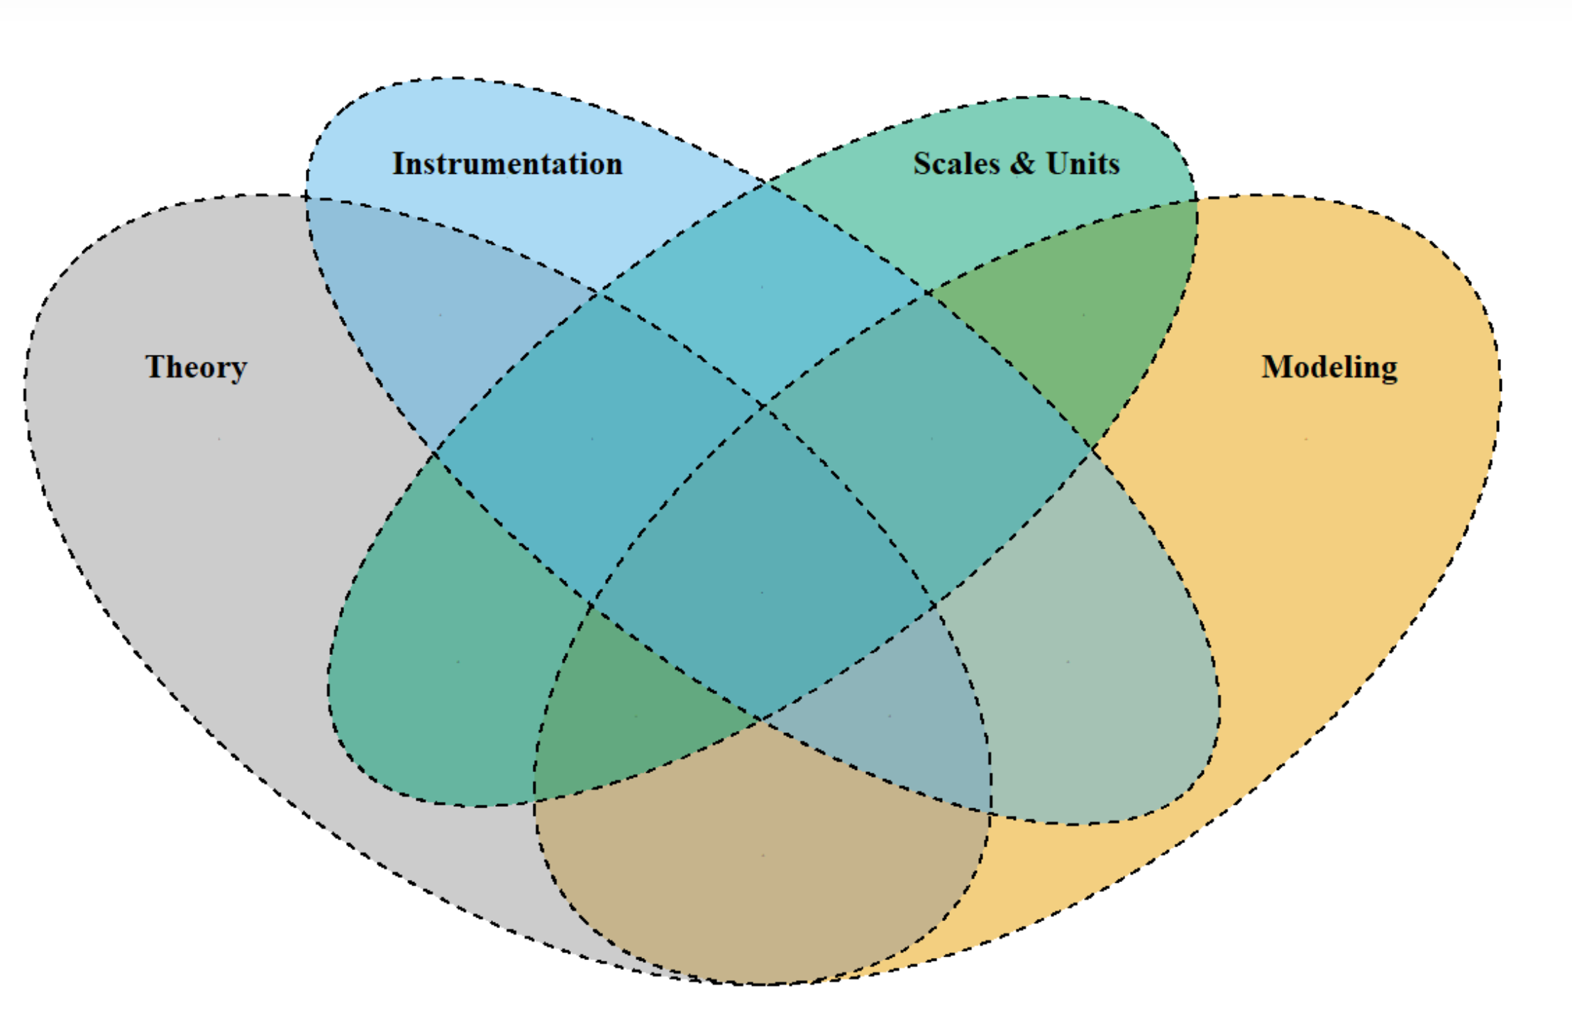
Can We Measure an LLM’s Intelligence?
THE PROBLEM
I, S, AND M
Not out of reach for an LLM benchmark
T: THE MISSING PIECE
Measurement presupposes variation that is there to be found
Within a model: temperature can be set to zero
Between models: optimizing to the same benchmarks compresses differences
LLM variability is designed, not discovered.
TISM framework (Briggs, Maul & McGrane, 2025)
Notes:
It has become common to describe progress along the AI frontier as measuring the intelligence or capability of a model, through benchmarks, arena leaderboards, and Elo-style ratings. Is this measurement in the sense understood in the human and physical sciences? I use the TISM framework: theory, instrumentation, scales and units, and modeling. Instrumentation, scales, and modeling are not out of reach for an LLM benchmark. The problem is theory, and specifically variability. Measurement exists to characterize variation in an attribute: within a person, as in psychophysics, and between people, as in the individual-differences tradition. That variation exists in an LLM, but it does not have the status that measurement requires. Within a model, output varies with temperature, prompt wording, context, and nondeterminism in inference. Across models, systems differ in architecture, data, and configuration. All of these are design parameters under the developer's control. Temperature can be set to zero. Prompt sensitivity is a defect to be engineered away. Frontier systems are optimized to the same benchmarks, which compresses the differences between them. Measurement presupposes variation that is there to be found; LLM development treats variation as something to manage and remove.

Slide 4
Measure People, Evaluate Models
THE PROBLEM
EVALUATION
MEASUREMENT
Are an AI system’s outputs fit for a use?
Is there a quantitative attribute to be estimated?
THE CONSTRUCT: CRITICAL AI LITERACY
The capacity to detect and repair, or where no objective check exists, to appraise and override, a plausible-but-wrong AI output that is not easily verified
The LLM is a powerful but non-stationary instrument, not an object of measurement.
Notes:
So I think we are pointing measurement at the wrong object. An LLM is better treated as instrumentation, a powerful but non-stationary instrument, than as a person-like object whose latent trait we estimate. The variability that remains abundant, and that matters, is in how people interact with these instruments. Put simply: measure human attributes, evaluate model capabilities. These are different epistemic activities. Evaluation asks whether an AI system's outputs are fit for a use. Measurement asks whether there is a quantitative attribute to be estimated. If there is a human construct worth measuring, a strong candidate is AI literacy: largely domain-general habits of mind, developed in domain-specific ways. I focus on one dimension, critical AI literacy, defined on the slide.
[If asked about Casabianca (2025), "Psychometrics is all you need": She argues that AI development and evaluation should be reimagined within a validity framework, using evidence-centered design and validity evidence for a use. She works in the argument-based validation tradition (Kane). Her "fluency effect," where judges conflate style with correctness, is close to what I call seductiveness. My paper asks a prior question from a measurement-realist tradition: is there a quantitative attribute to be measured at all? For the LLM, I argue there is not. Her work is the rigorous account of evaluating models; mine is about measuring people. What "psychometrics is all you need" supplies is validation, not measurement. ]

Slide 5
An Item: Accept or Override an LLM Response
THE MODEL
A bank of LLM responses: some correct (C), some erroneous (E)
ACCEPT
OVERRIDE
The person accepts each response or overrides it
X = 1
X = 0
LLM Correct (C)
X = 1 if and only if the decision is correct
1 − f(θ)
f(θ): false alarm
probability c
c = P(C)
X = 0
X = 1
LLM Erroneous (E)
The share of correct responses in the bank, which is the model’s capability
1 − h(θ): error missed
h(θ): error caught
probability 1 − c
h(θ) = P(override | E, θ)
f(θ) = P(override | C, θ)
Notes:
Here is the measurement setup. Let's define an item as a single interaction between a person and an LLM. The stimulus is an LLM response to a prompt. Across the bank, some responses are correct and some contain one or more errors. The person decides whether to accept the response or override it. X = 1 if the decision is correct: a correct response accepted, or an erroneous one overridden. Whether a response is erroneous is a property of the item, not the person.
c is the share of correct responses in the bank. Because the model generated the bank, c is the model's capability in that domain. The person's behavior is described by two conditional probabilities, both functions of critical AI literacy theta: h of theta, the probability of catching an erroneous response, and f of theta, the probability of overriding a correct one, a false alarm.

Slide 6
From Total Probability to a Constrained 3PL
THE MODEL
LAW OF TOTAL PROBABILITY, OVER C AND E
P(X = 1 | θ) = c[1 − f(θ)] + (1 − c) h(θ)
θ critical AI literacy, an attribute of the person
c model capability, the lower asymptote
ASSUMPTION A
f(θ) = 0 for all θ
s seductiveness of the response
h(θ) = 1 / {1 + exp[−a(θ − δ(s))]}
δ(s) difficulty of overriding, on the θ scale
RESULT
a discrimination, fixed across items
P(X = 1 | θ) = c + (1 − c) h(θ)
c is a substantive parameter, not a guessing nuisance.
As θ → −∞, h(θ) → 0 and P(X = 1 | θ) → c
Notes:
By the law of total probability over the two states of the response, the first eqn shows the probability of a correct response. This decomposition holds for any h and f. To get a model I make two assumptions. First, f of theta--the prob of an override when a response is correct is zero for all theta: critical AI literacy raises the probability of overriding an error without raising the probability of overriding a correct response. It is a continuum of honed discernment, not some function of ingrained skepticism. Second, h of theta is logistic in the gap between the person's critical AI literacy and the difficulty of overriding the item. The result is the equation in the last box which with a little substitution should look familiar: it's a constrained three-parameter logistic item with fixed discrimination. As theta goes to minus infinity, h goes to zero and the probability goes to c. A person who accepts every response scores c: their accuracy is the model's capability. The lower asymptote here is not a nuisance guessing parameter. It is a substantive parameter of interest. Delta of s is the value of theta at which a person has an even chance of overriding an error; it increases with what I would describe as the "seductiveness" of the response, the degree to which its style makes a flaw harder to see. The model also assumes conditional independence given theta.

Slide 7
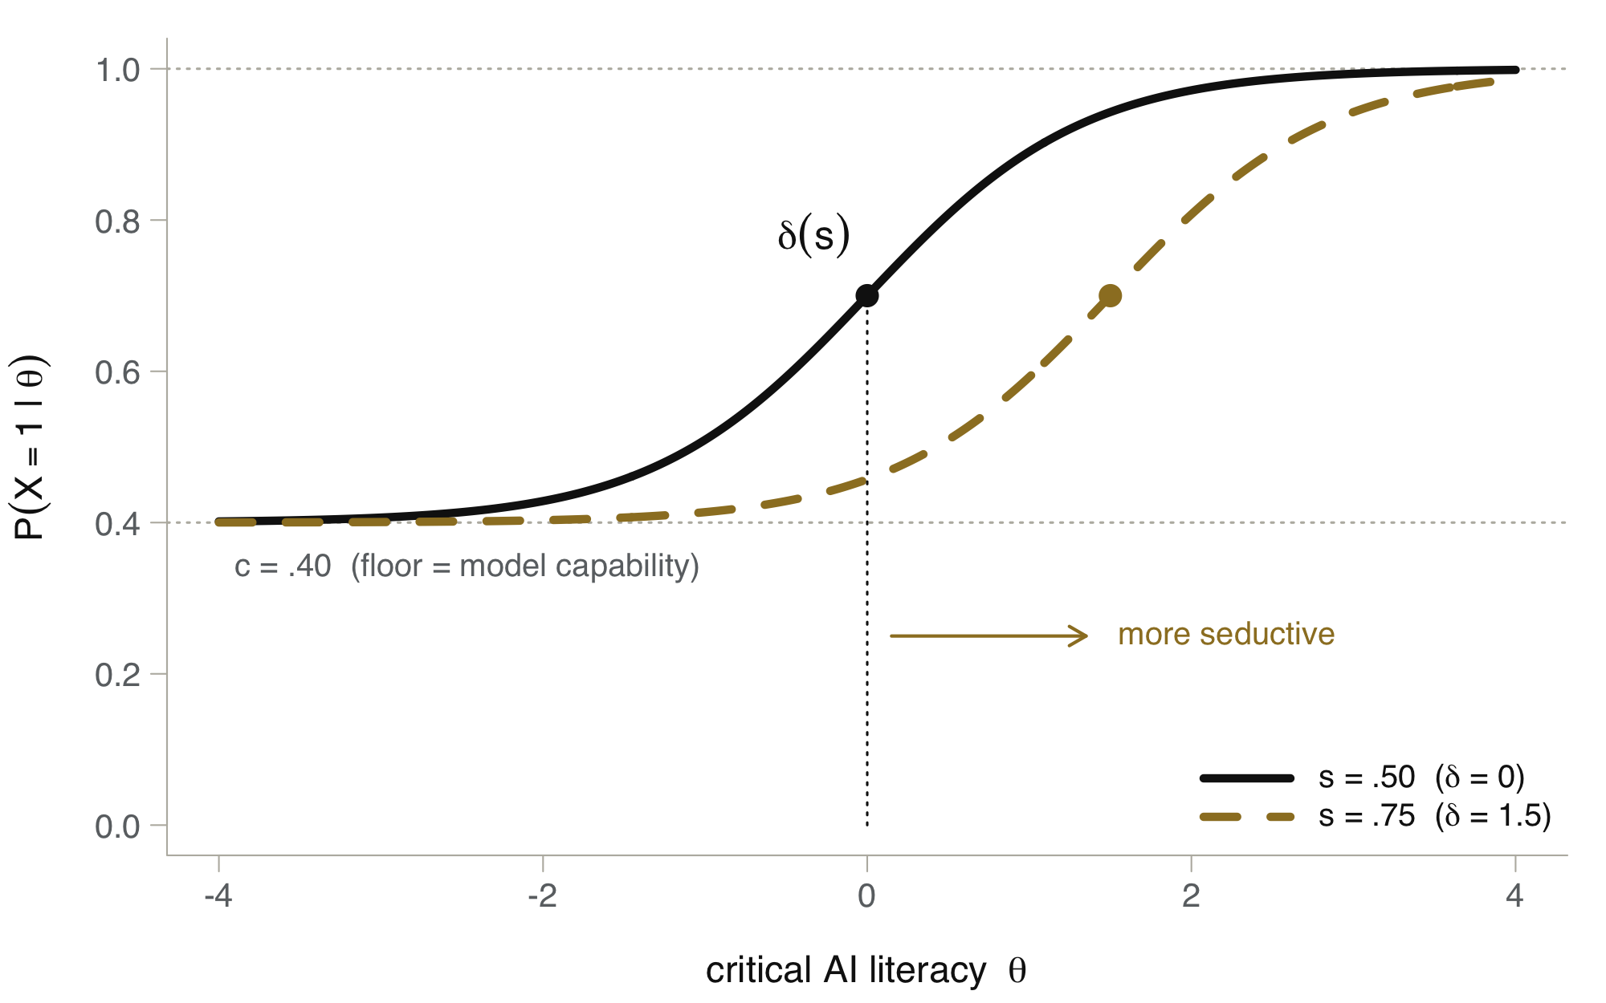
Item Characteristic Curves
THE MODEL
FLOOR = c
A person who accepts every response scores c
LOCATION = δ(s)
More seductive responses shift the curve to the right
As capability rises, the floor rises and the room for critical AI literacy shrinks
a = 1.5, δ(s) = −3 + 6s. Each point marks P(X = 1 | θ) = (c + 1) / 2 at θ = δ(s).
Notes:
Here is what an item characteristic curve looks like. The floor is c, here .40: the accuracy of a person who accepts every response. The location is delta of s. A more seductive response shifts the curve to the right, so it takes more critical AI literacy to have an even chance of catching the error. The key point for what follows: as model capability rises, the floor rises, and the room for critical AI literacy to matter shrinks. The measurement value of an item is its Fisher information, averaged over a population with theta distributed standard normal.

Slide 8
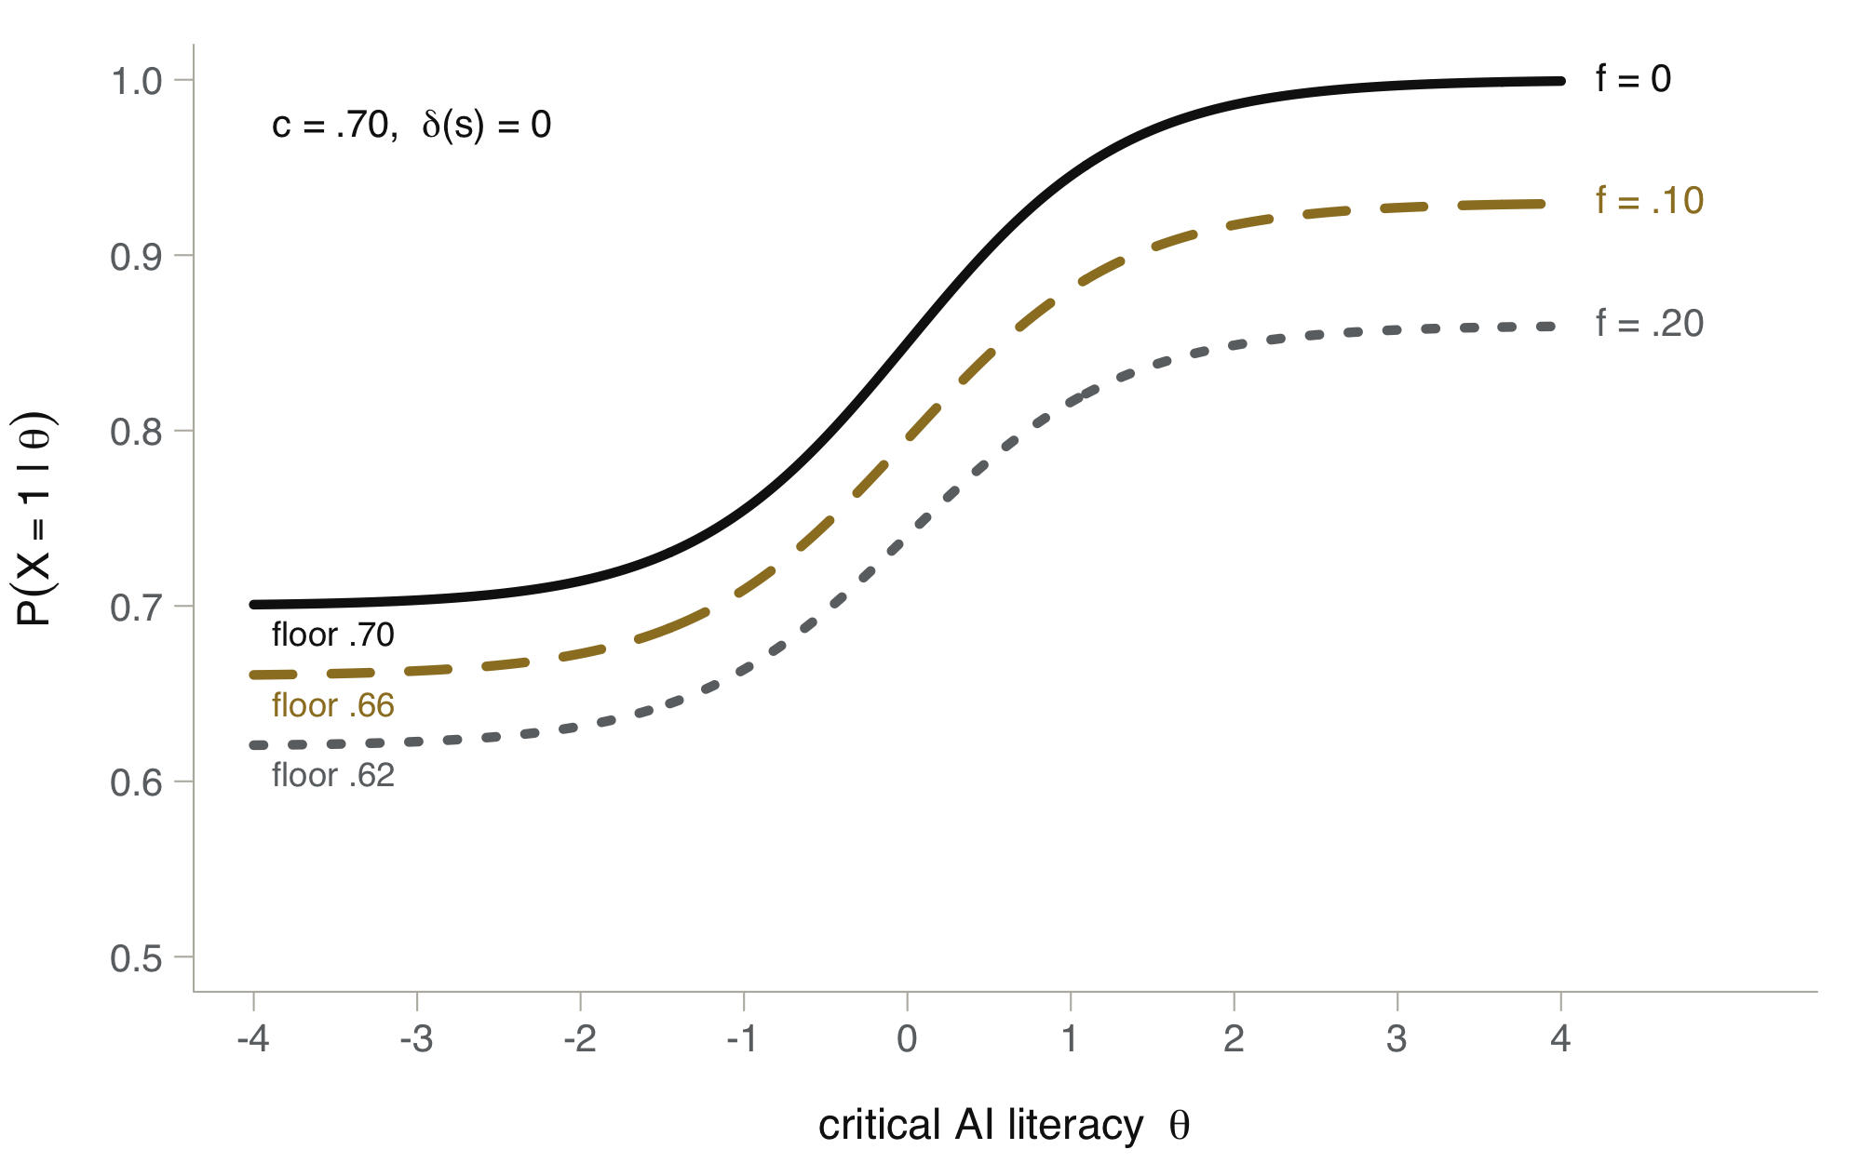
Assumption B: A Fixed Override Criterion
THE MODEL
SIGNAL DETECTION
Override when evidence of error exceeds a criterion k
h(θ) = Φ(d′(θ, s) − k), f = Φ(−k)
f reflects skepticism, not discernment
THE FLOOR DROPS WHEN c > .5
As θ → −∞, h(θ) → f
floor = c(1 − f) + (1 − c) f
floor − c = f(1 − 2c)
Same conclusion: as c → 1, P(X = 1 | θ) → 1 − f for every θ
Curves: c = .70, δ(s) = 0, a = 1.5, h(θ) = f + (1 − f) L(θ). Floors match Table A1; derivation in Appendix A.
Notes:
Assumption A, f of theta equals zero, is what makes c the lower asymptote, and it may be unrealistic. Some people will override a correct response whatever their critical AI literacy. Signal detection theory makes the alternative precise. Suppose a person overrides when the evidence that a response is erroneous exceeds a criterion k. Erroneous responses generate evidence centered at d-prime, which increases with theta and decreases with seductiveness; correct responses are centered at zero. Then h of theta is Phi of d-prime minus k, and the false-alarm rate f is Phi of minus k. f depends on k alone: it is a disposition to override, not an ability to discriminate. As theta goes to minus infinity, d-prime goes to zero, the person cannot tell erroneous from correct responses, and overrides both at the same rate, so h goes to f. The floor becomes c times one minus f plus one minus c times f. Subtract c and you get f times one minus 2c, which is negative whenever c is above one half. Overriding indiscriminately ruins a share f of the correct responses and, by chance, repairs a share f of the erroneous ones. When the model is usually right, the loss dominates. The figure shows c = .70: the floors are .70, .66, and .62, the same values as Table A1. Note also that under B the curves level off at 1 minus c f, not at 1. The conclusion does not change. f does not depend on theta, so as c goes to 1 the success probability goes to the constant 1 minus f for every person, and the item carries no information about critical AI literacy. Discrimination can be observed only when the bank holds erroneous responses to be discriminated from correct ones.

Slide 9
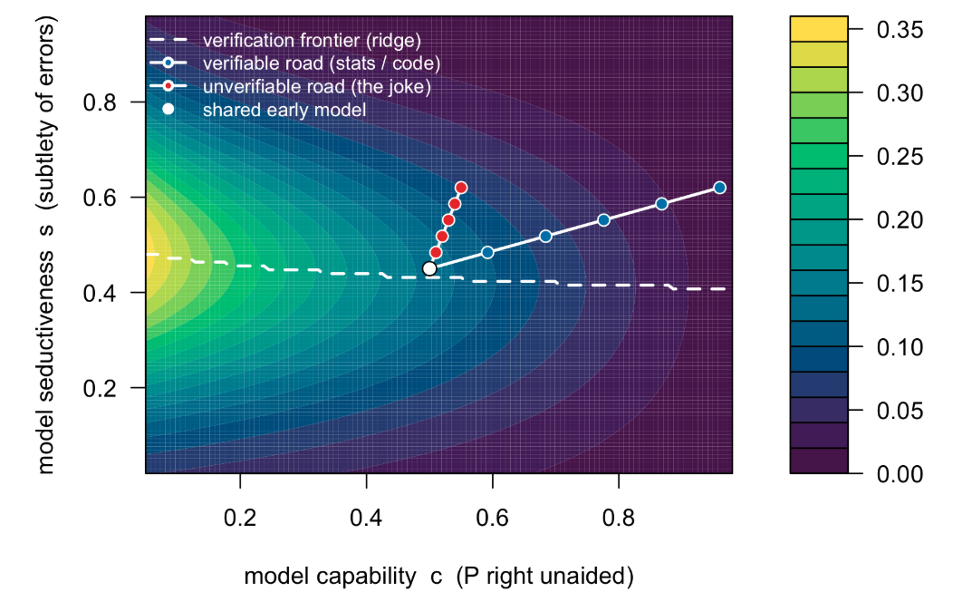


Two Domains Across Model Generations
THE VERIFICATION FRONTIER
SHARED START
Same early model in both domains: c = .50, s = .45
Errors grow subtler: s rises to .62 in both
Verifiable (code, statistics)
A clean training signal: c climbs to .96
Unverifiable (the joke)
No objective signal: c plateaus at .55
Shading: expected item information, θ ~ N(0, 1). Dashed line: verification frontier. a = 1.5, δ(s) = −3 + 6s, f(θ) = 0.
Notes:
To see how the measurability of critical AI literacy changes as models improve, I trace two domains across model generations. Both start at the same early model, c = .50 and s = .45. With each generation of LLMs the responses, and the errors that remain in them, become subtler, so seductiveness rises the same in both domains, to .62 at the frontier.
Capability diverges. In the verifiable domain, a clean training signal drives c toward a ceiling near 1, here .96. In the unverifiable domain there is no objective signal to optimize against, and capability plateaus at .55. The shading is the expected information per item about critical AI literacy. Information lives on a ridge, the verification frontier, at intermediate seductiveness. The ridge (dashed white line) is the value of s that maximizes information for a given value of c. Information falls toward zero where the model is so capable that it rarely makes an error. The verifiable road, in blue, climbs right into that low-information region. The unverifiable road, in red, stays near the ridge.

Slide 10
Items Needed to Reach a Marginal Reliability of .80
THE VERIFICATION FRONTIER
30
719
50
Shared early LLM
Frontier LLM, verifiable (code)
Frontier LLM, unverifiable (joke)
c = .50, s = .45
Avg. info per item .1323
c = .96, s = .62
Avg. info per item .0056
c = .55, s = .62
Avg. info per item .0801
Critical AI literacy is most measurable where the AI, on its own, can help the least.
With Var(θ) = 1, ρ = I / (I + 1), so ρ = .80 needs I = 4 and n = 4 / Ī items. As c → 1, P(X = 1 | θ) → 1 for every θ.
Notes:
Some numbers. For theta with unit variance, a reliability of .80 needs total information 4, and the number of items is 4 divided by the average information per item. Because the average is over the population, this is the number of items a randomly drawn person needs. Both domains start equally measurable: about 30 items.
At the frontier, the verifiable domain yields almost no information per item: you would need about 719 items. The unverifiable domain still needs only about 50.
This is a consequence of the functional form, not an empirical finding. As c goes to 1, the success probability goes to 1 for every theta, and the item stops discriminating among people. The simulation illustrates the mechanism; it does not estimate its size, and the numbers depend on the parameter values. The lesson is counterintuitive: critical AI literacy is most measurable exactly where the AI, on its own, can help the least. Where verification is cheap and the model is strong, the construct collapses to whether the user bothered to check. Where verification is expensive and judgment can't be removed, the construct persists.

Slide 11
Toward an Empirical Program
WHAT FOLLOWS
The objection: scoring X needs the very verification that is expensive. Is measurement of critical AI literacy a lost cause?
1
2
3
Calibrate once, administer many times
Unverifiable in the wild is not unscorable in the lab
Prediction of future success is the central task
Pay the cost of verification once: a bank of AI outputs with expert keys, correct and erroneous in known proportion
Build stimuli with a known key: a buried non sequitur, a dropped qualifier, an overgeneralized recommendation
Does critical AI literacy measured in the lab forecast judgments in practice –a funny story at a dinner party?
Limit: where no convergent verdict exists even in principle, there is no key, and critical AI literacy is undefined.
Notes:
If critical AI literacy is most measurable where verification is expensive or deferred, and scoring X needs that very verification, is measurement a lost cause? The objection conflates two costs that measurement keeps apart: the one-time cost of calibrating an instrument, and the recurring cost of administering it. We don't verify an examinee's answer as it is given; we compare it to an answer key fixed when the test was built. So: assemble a bank of AI outputs in hard-to-verify domains, each with an expert-validated verdict, and pay the verification cost once, during test construction. The bank has to have both correct and erroneous responses in known proportion; without erroneous responses, critical AI literacy can't be identified. Unverifiable in the wild need not mean unkeyable in the lab. We can build stimuli whose correct judgment is known by design. The surface fluency that hides the flaw is real, but the key is fixed in advance by expert consensus. That clarifies what the measure is for. Its value is predictive: it should forecast the quality of a person's judgments in practice, where verification is absent, since when a professional relies on AI, errors are subtle, and checking is impractical. Showing that lab-measured critical AI literacy predicts real-world success is the central validation task and the natural next study. None of this rescues the genuinely unverifiable extreme. The tractable target is the broad middle: domains with a defensible verdict at a manageable cost.

Slide 12
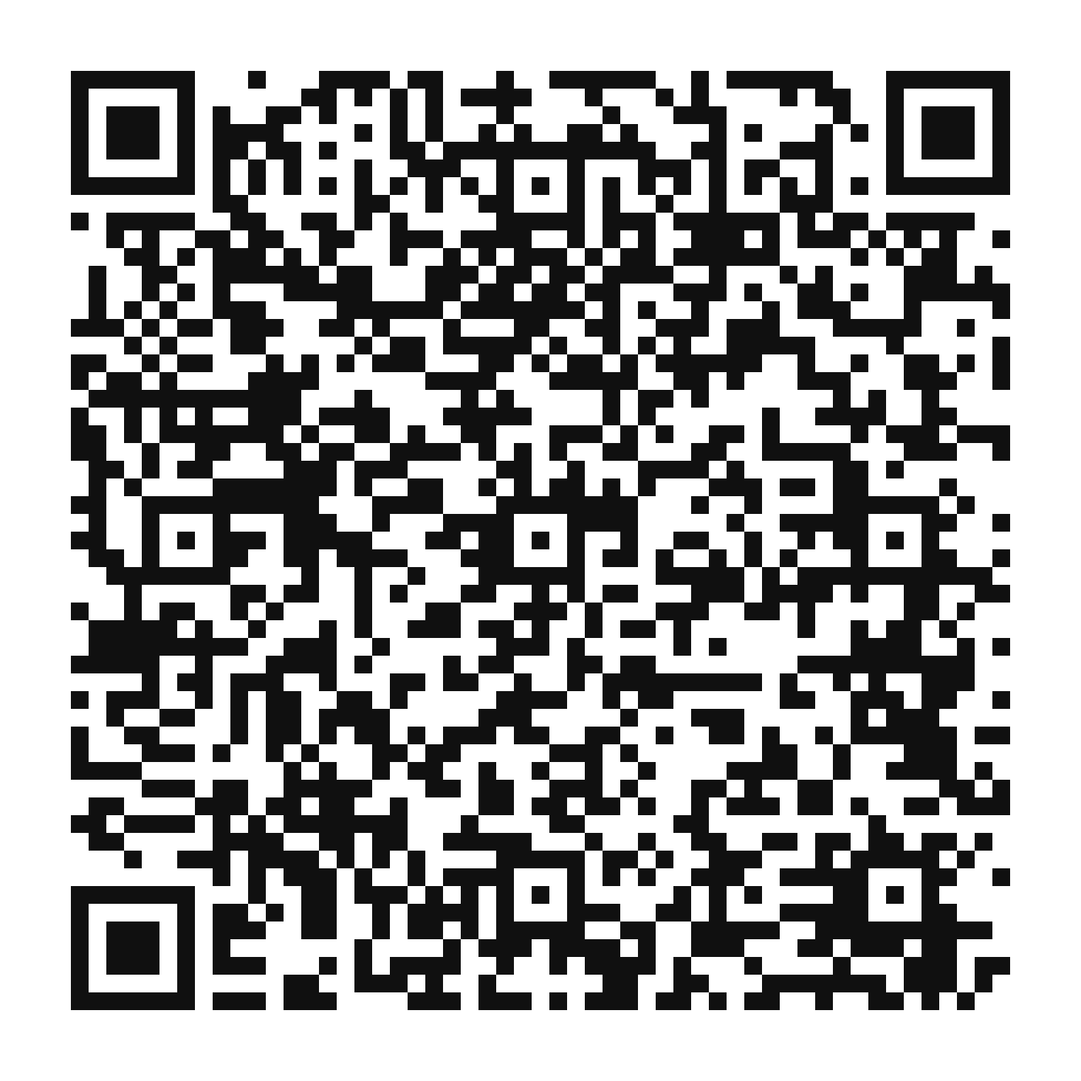
Three Takeaways
SUMMARY
1
To treat LLM capability as a latent trait is, absent a substantive theory, largely a category error
2
Measurement is relocated to the person, and made harder by a non-stationary instrument that compresses the variance we want to detect
The paper (AIME-Con 2026 Proceedings version)
3
AI-literacy constructs are socially constructed and in flux: we are at the thermoscope stage
Simulation and transcript: SSM 2026 folder on GitHub
derek.briggs@colorado.edu
Thank you · Blog on AI literacy and informed skepticism: derekcbriggs.github.io/blog.html
Notes:
In summary, three takeaways.
First, to speak of measuring an LLM's capability as a latent trait is, absent a substantive theory of the construct, largely a category error.
Second, measurement has not become irrelevant. It has been relocated to the person, and made harder by the very instrument that occasions it. We measure the person through a non-stationary instrument engineered to compress the variance we want to detect. It is like measuring penmanship in the age of the word processor, or navigation in the age of GPS: the tool raises the floor and can erase the differences that once defined the construct.
Third, the AI-literacy constructs that matter now are socially constructed and in flux. By the standards of physical measurement, we are at the thermoscope stage.
The QR code links to the paper on GitHub. Thank you!

